Slide 1
BOOSTING ALGORITHMS
S.Krithika

Slide 2
Introduction
‘Boosting’ refers to a family of algorithms which converts weak learner to strong learners.
A method in Machine Learning to reduce errors in predictive data analysis
Improves predictive accuracy of models by combining multiple weak learners.
Trains Multiple Models sequentially to improve the accuracy of overall system.
Types :
Ada Boost
XG Boosting
LG Boosting

Slide 3
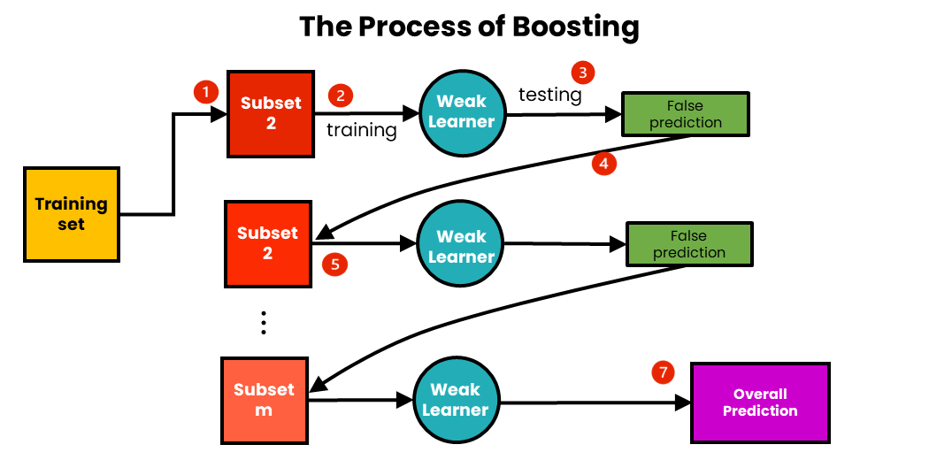

Slide 4
AdaBoost (Adaptive Boosting)
AdaBoost is the most popular boosting algorithms.
It assigns weights to training instances and adjusts these weights based on the performance of weak learners.
It focuses on misclassified instances, allowing subsequent weak learners to concentrate on these samples.
The final prediction is determined by aggregating the predictions of all weak learners through a weighted majority vote.

Slide 5
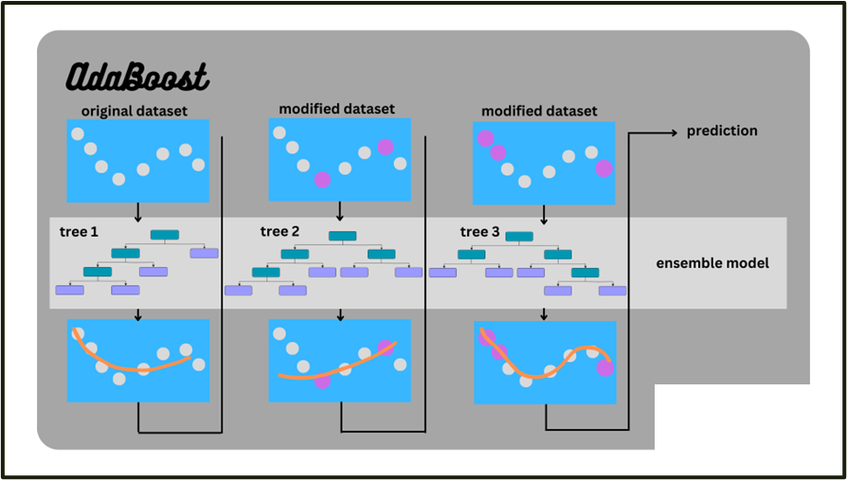
AdaBoost

Slide 6
XGBoost (Extreme Gradient Boosting)
XGBoost is an advanced boosting algorithm that combines gradient boosting with regularization techniques.
It incorporates both tree-based models and linear models to enhance performance and efficiency.
It uses a combination of gradient boosting and regularization strategies to prevent overfitting.
It is known for its speed, scalability, and ability to handle large-scale datasets effectively.

Slide 7
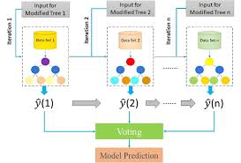
XGBoost

Slide 8
Light GBM (Light Gradient Boosting Machine)
Light GBM is a high-performance boosting algorithm that uses a leaf-wise approach to construct decision trees.
It prioritizes growing the leaf nodes that reduce the loss the most, resulting in faster training times.
It is particularly efficient when dealing with large datasets and is widely used in competitions and industry applications.

Slide 9
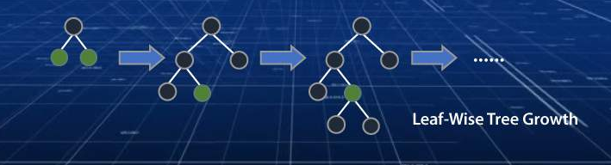
Light GBM

Slide 10
Advantages of Boosting
Efficient computation
Reduction in Bias
Ease of Implementation

Slide 11
THANK YOU

